Slide 1
Eyes on the Driver: a Machine Learning Approach to Distracted Driving
By Legolas Zhang

Slide 2

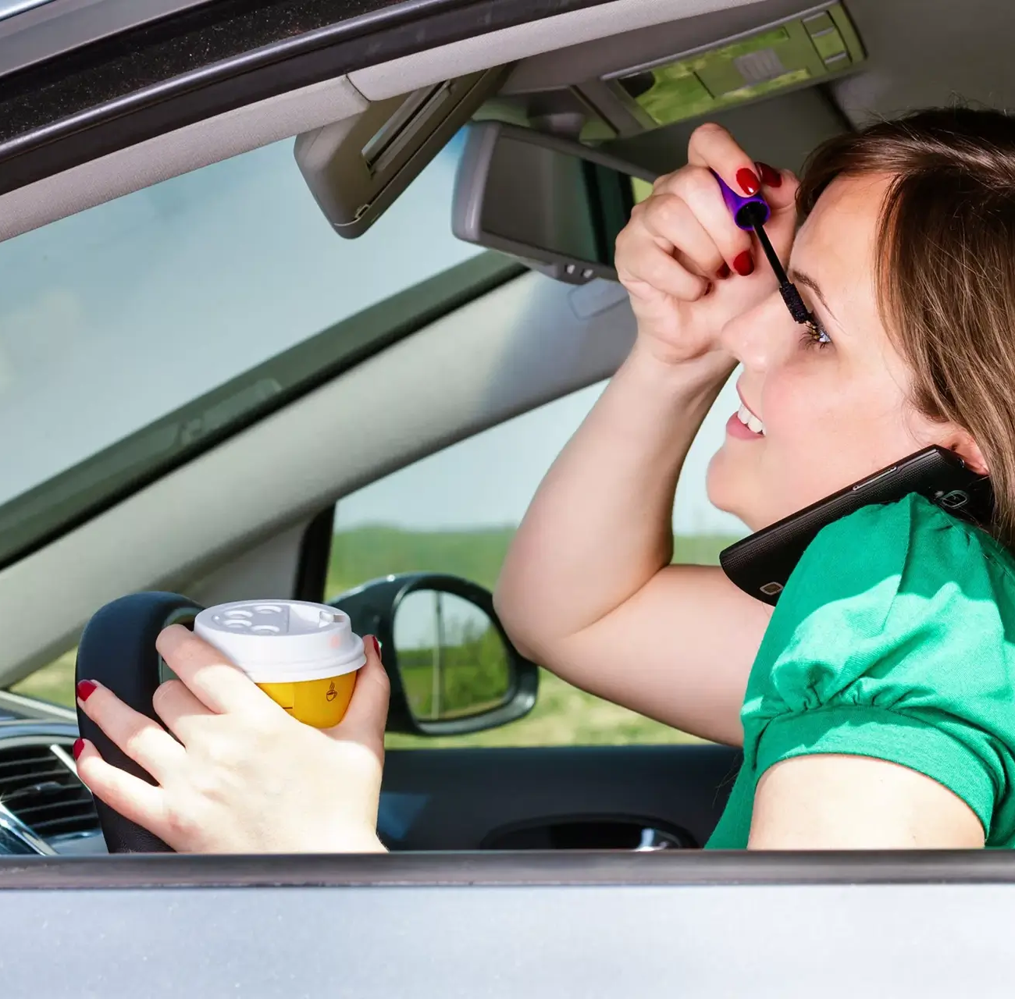

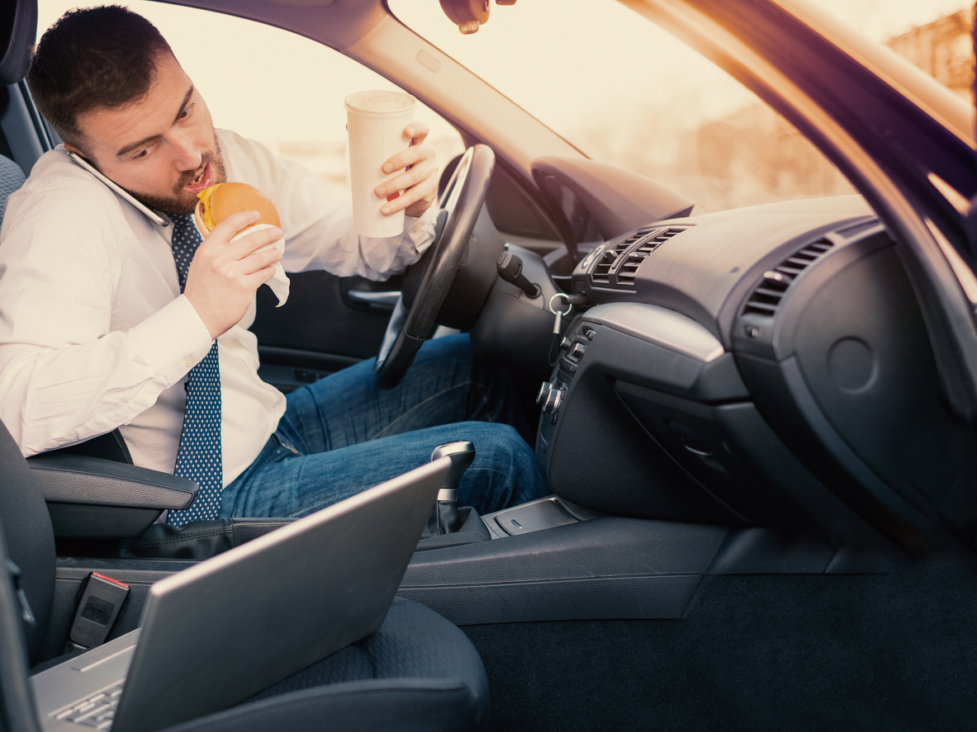
Why
More than 20% of fatal collisions in Canada are caused by distracted driving (CACP)
80% of surveyed drivers admit to being distracted while driving (CAA)
Police can’t handle growing numbers of distracted drivers
AI can help by quickly detecting distracted driving.

Slide 3
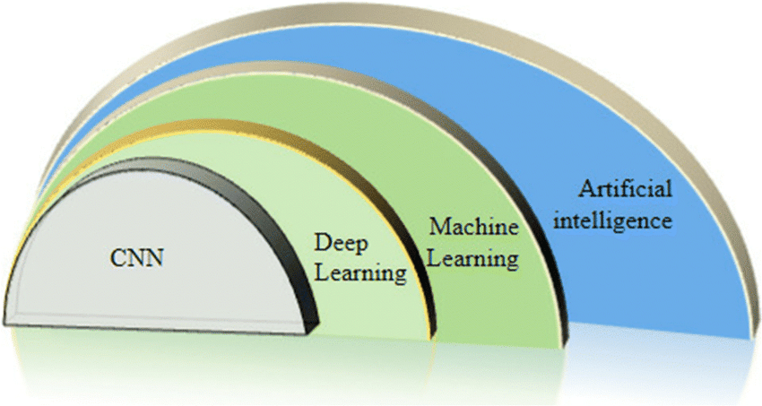
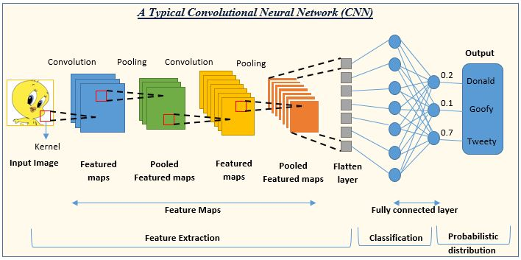
Goals
Develop a prototype Convolutional Neural Network (CNN) for detecting distracted driving, as a proof of concept before implementation in real vehicles
Create a lightweight and efficient enough CNN to run without specialized hardware
Make the CNN accurate, even under challenging conditions

Slide 4


Dataset and Tools
Trained and tested with State Farm 2021 Distracted Driving Dataset of over 13,000 images
Platform: Tensorflow Keras to build, train, and test the model itself
Python Libraries: Numpy, Matplotlib, cv2
Data analysis and visualization: Seaborn
Server to run CNN program: Google Colab

Slide 5
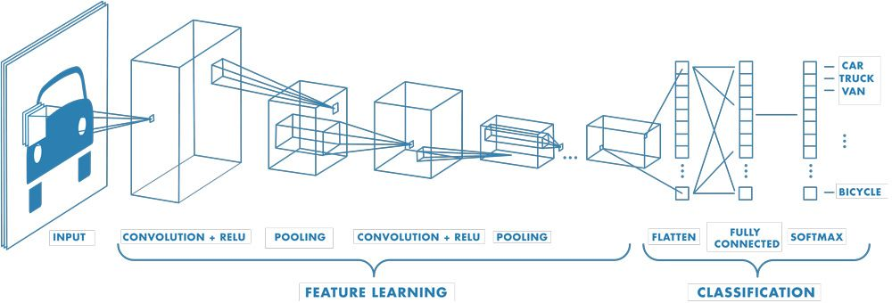
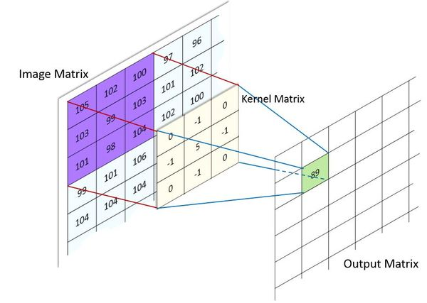
What is a CNN
A network architecture for deep learning
Mimic how human visual cortex works to interpret visual data with entire images
CNNs have series of layers to detect different characteristics of input images
Best for image processing and analysis with higher accuracy and shorter test time than traditional methods

Slide 6
CNN DEVELOPMENT
PRE-CNN
Created linear regression model for initial testing, to make sure CNN was best candidate
Experimented with Perceptron model to gain insight into how images are classified
INITIAL CNN
Created simple CNN for initial testing
Added visualizations to look inside CNN

Slide 7
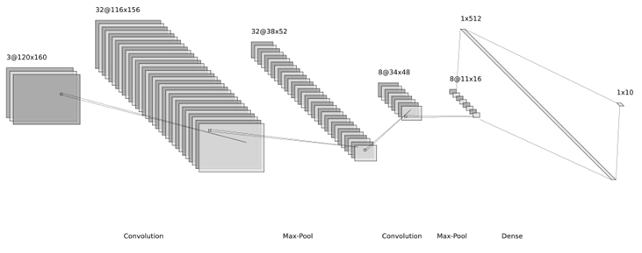
CNN DEVELOPMENT (Cont.)
FINE-TUNED CNN
Decided on number of parameters and layers with consideration of accuracy and speed
Trade-off between performance and cost (computer speed and memory)
Refined and tweaked using visualizations from previous models

Slide 8
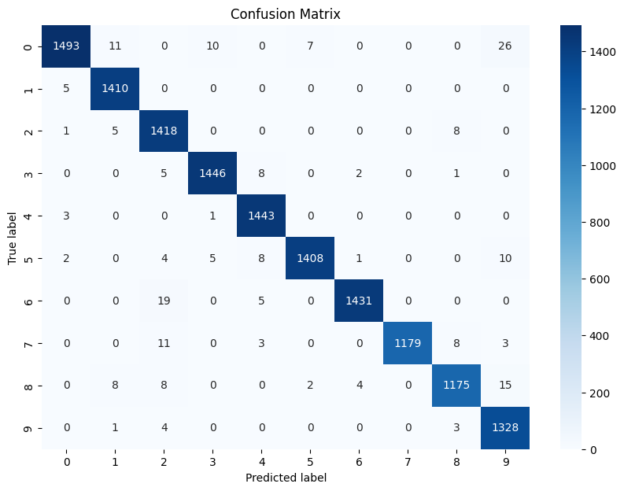
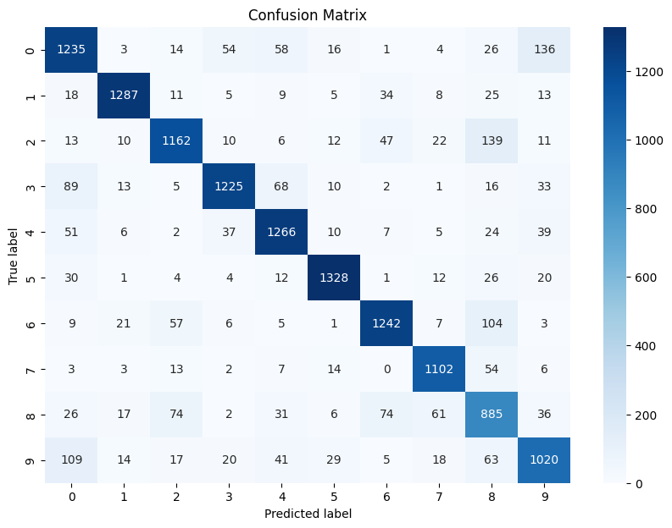
Results & Analysis
Without transformations, CNN achieves around 99% accuracy
With transformations, CNN achieves 86% accuracy
Final model size: 2.8 MB

Slide 9
Conclusion
CNN works with high accuracy and efficiency
Compared to other CNN models, lightweight with favorable accuracy
In challenging conditions, still works well but with reduced accuracy

Slide 10
Pros and Cons
Pros:
Lightweight
Accurate
Fast enough to detect in timely manner
Economic design provides great potential for integration into real cars
Cons:
Accuracy drops with challenging conditions
Static
Rotation
Shift

Slide 11

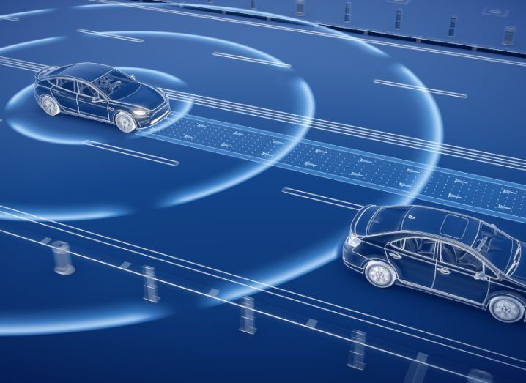
What’s next
Extend the algorithm to accept and analyze facial images to improve accuracy
Explore the opportunity to embed this lightweight CNN in real driving assistance systems with webcams

